Slide 1

APPLICATION OF ICT
PROJECT
M. Usman / 73904
M. Usman / 76615
M. Zeeshan / 72612
M. Husnain Haider Mansha / 76802

Slide 2
MS WORD
We took a Research Paper online through this link:
https://doi.org/10.1186/s12885-020-06957-4
And applied following guidelines which are given below:
Proper use of Heading, Subheadings, Font-Size, and Styles.
Accurate Alignment, Margins, Spacing, and Page-Layout.
Use of Tables, Charts, and Images.
Correct Applications of Citations and References.

Slide 3


Slide 4
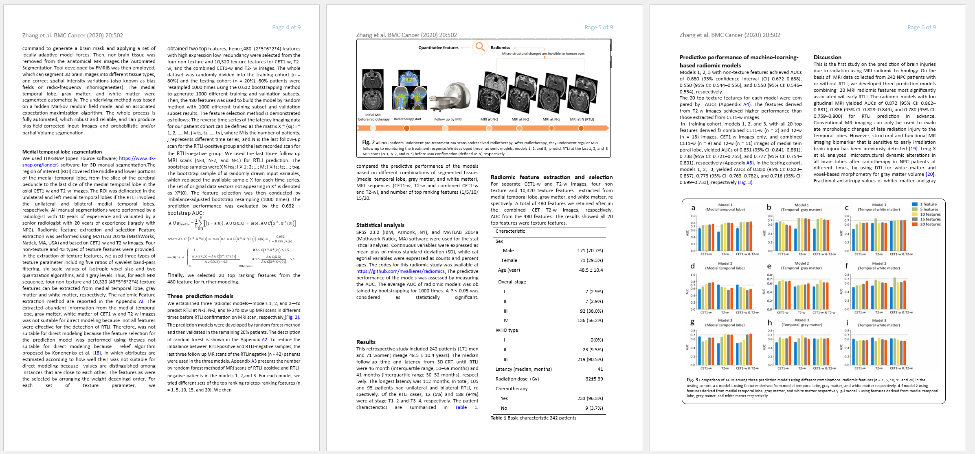

Slide 5
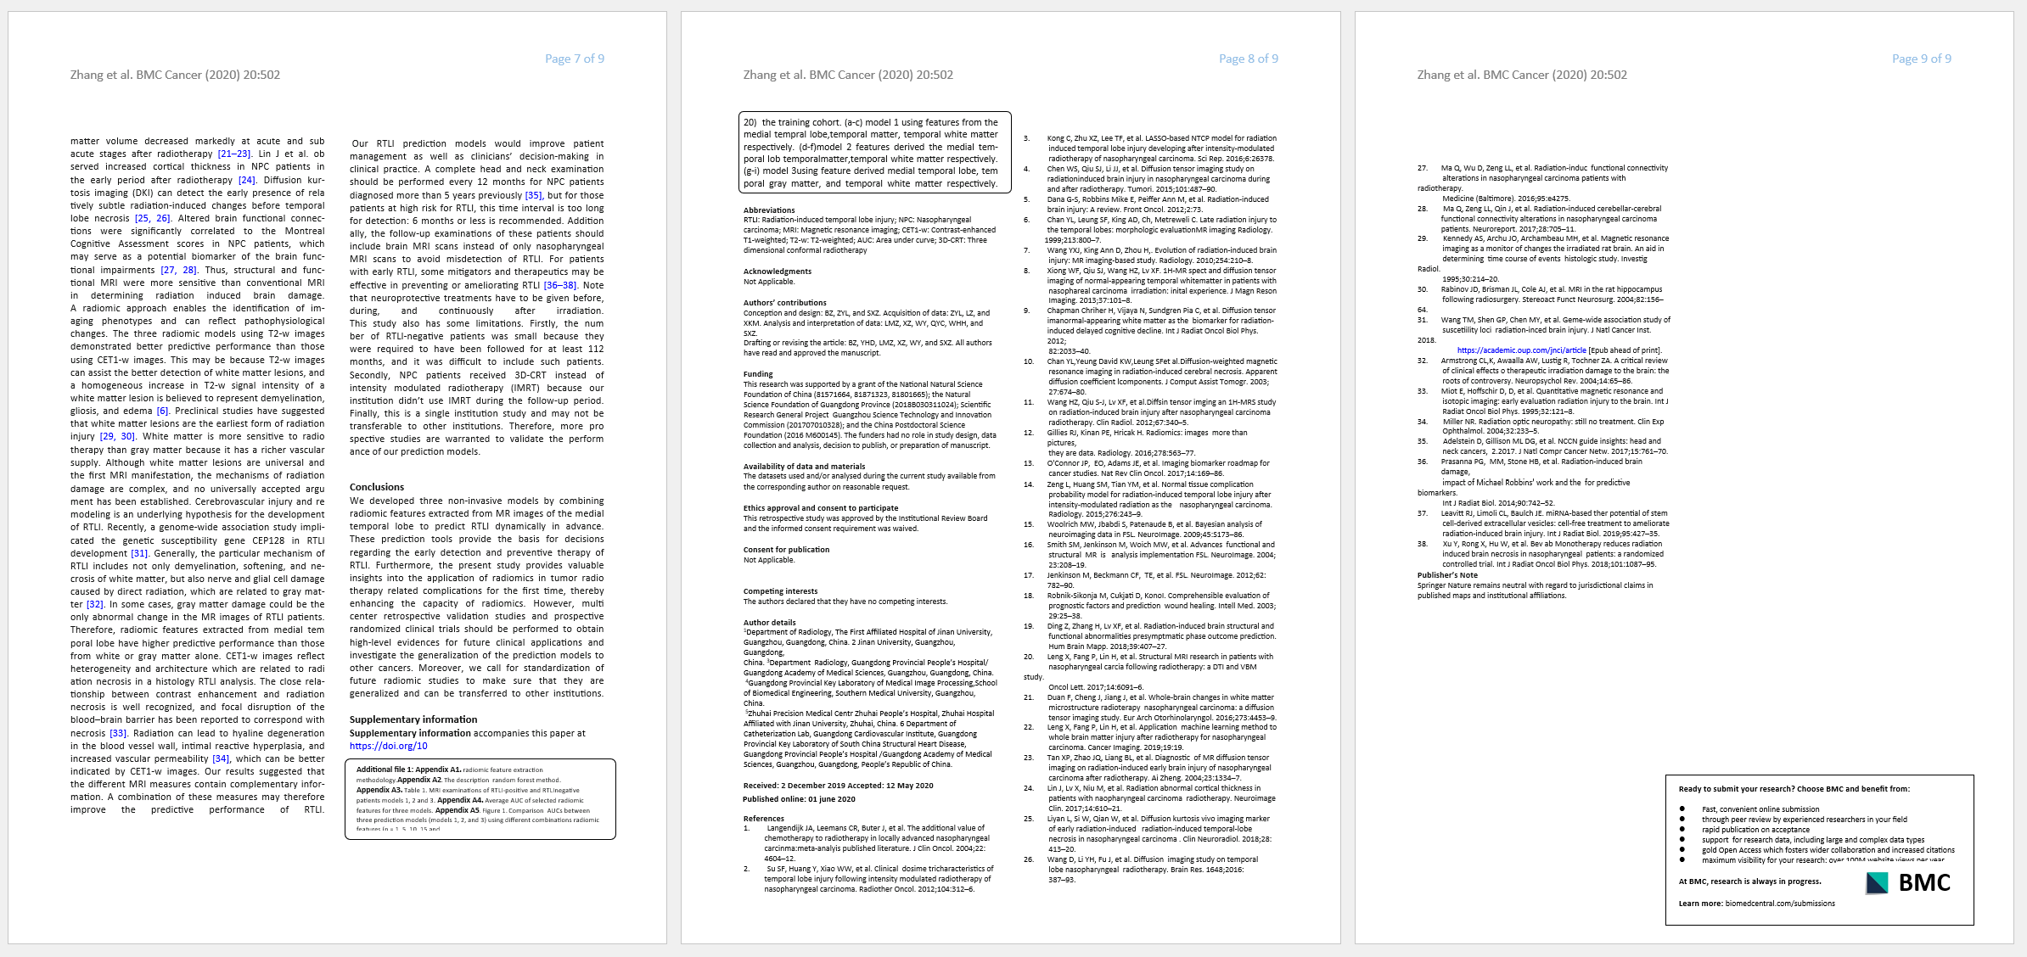

Slide 6
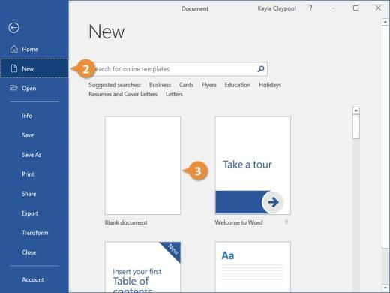
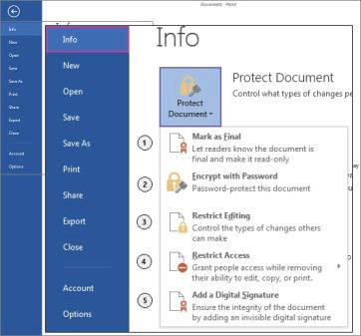
Introduction:
This project is based on a Research Article in MS Word. This research is done using information from link.springer.com. The website provides useful and reliable research material. The document is prepared using headings, columns, hyperlinks, bookmarks, and pictures to make it simple and easy to read.
Document
Open Word and click New.
Select Blank Document
Save Document
Click File → Save.
Choose location, type name, click Save.

Slide 7
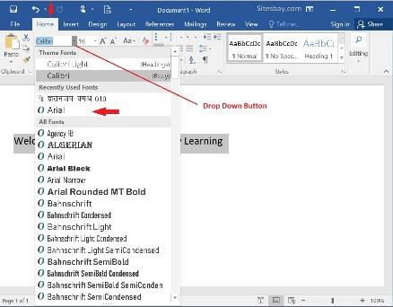
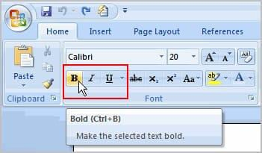
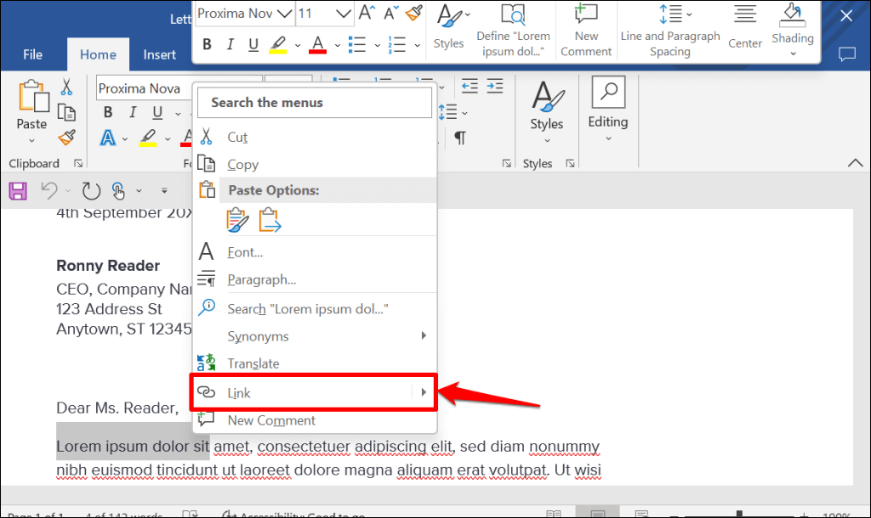
Change Font
Select text.
Choose font style and size from Home tab
Bold / Italic / Underline
Select text.
Click B, I, or U in Home tab
Hyperlinks
Select the text or image you want to make a hyperlink.
Right-click and choose Link (or press Ctrl + K).
Paste the web address (URL) and click OK.

Slide 8
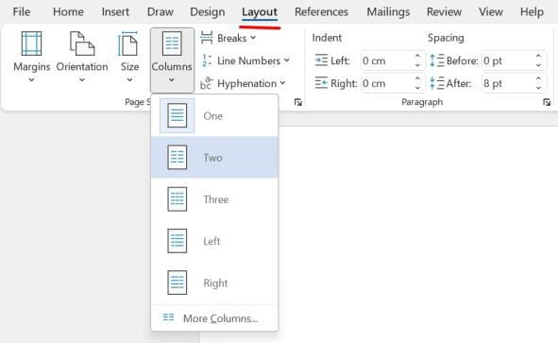
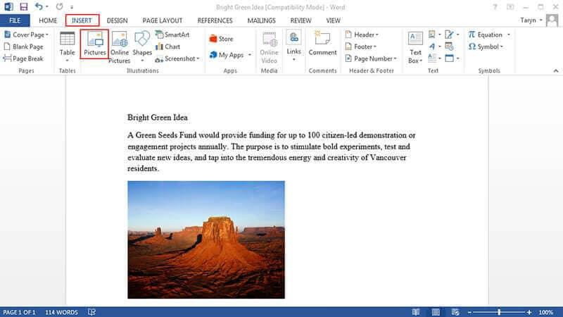
Column:
Open your Word document and click where you want to insert the table.
Go to the Insert tab and click on Table.
Select the number of rows and columns from the grid, or choose Insert Table for custom size.
Picture insert:
Click where you want to insert the picture in the document.
Go to the Insert tab and click Pictures.
Choose This Device or Online Pictures,
select the image, and click Insert’s

Slide 9
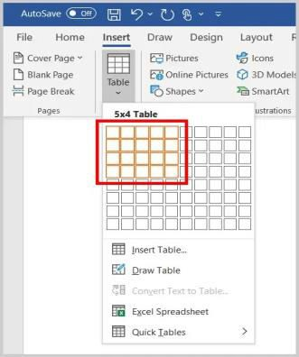
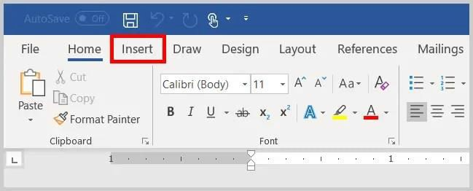
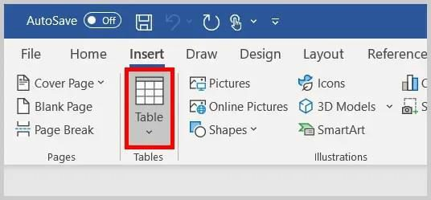
Table add:
Click where you want to add the table in your document.
Go to the Insert tab and click Table.
Select the number of rows and columns, and the table will be added.

Slide 10
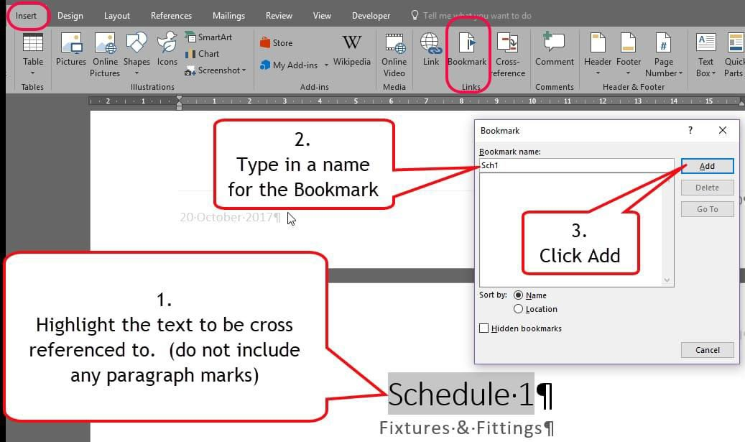
Bookmark:
First, we click on the Insert tab. Then, we see the Bookmark icon. We select the text where we want to add the bookmark, write the name of the bookmark, and click Add. After that, we select the text we want to click, go to Bookmark, and we move the desired location.

Slide 11
MS Excel
We created an Inventory Management System of Computer Shop using the following data:
Used MACROS and Other formulas.
Created Pivot Tables for data analysis.
Designed Graphs to represent data visually.
Ensure Proper formatting and Structure.

Slide 12
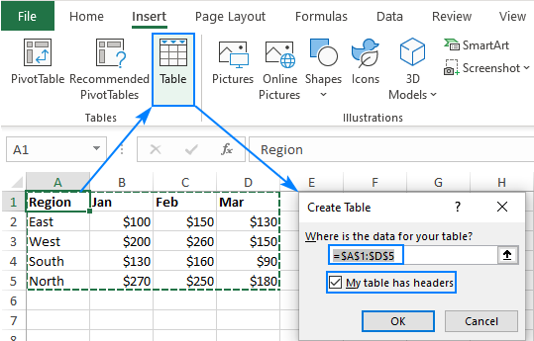
How to add table:
Select any cell within your data set.
On the Insert tab, in the Tables group, click the Table button or press the Ctrl + T shortcut.
The Create Table dialog box appears with all the data selected for you automatically; you can adjust the range if needed. If you want the first row of data to become the table headers, make sure the My table has headers box is selected.
Click OK.

Slide 13
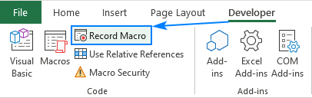

How to add macros in excel:
To record a macro in Excel, carry out these steps:
On the Developer tab, in the Code group, click the Record Macro button
Alternatively, click the Record Macro button on the left side of the Status bar:

Slide 14
In the Record Macro dialog box that appears, configure the main parameters of your macro: In the Macro name box, enter the name for your macro. Try to make it meaningful and descriptive, so later on you will be able to quickly find the macro in the list.
In macro names, you can use letters, numbers, and underscores; the first character must be a letter. Spaces are not allowed, so you should either keep a name single-worded starting each part with a capital letter (e.g. MyFirstMacro) or separate words with underscores (e.g. My_First_Macro).
In the Shortcut key box, type any letter to assign a keyboard shortcut to the macro (optional).
Both uppercase or lowercase letters are allowed, but you'd be wise to use uppercase key combinations (Ctrl + Shift + letter) because macro shortcuts override any default Excel shortcuts while the workbook containing the macro is open. For example, if you assign Ctrl + S to a macro, you will lose the ability to save your Excel files with a shortcut. Assigning Ctrl + Shift + S will keep the standard saving shortcut.
From the Store macro in drop-down list, choose where you want to store your macro:
  Personal Macro Workbook – stores the macro to a special workbook called Personal.xlsb. All the macros stored in this workbook are available whenever you use Excel.
  This Workbook (default) - the macro will be stored in the current workbook and will be available when you reopen the workbook or share it with other users.
  New Workbook – creates a new workbook and records the macro to that workbook.
In the Description box, type a short description of what your macro does (optional).
Though this field is optional, I'd recommend you always provide a brief description. When you create a lot of different macros, it will help you quickly understand what each macro does.
Click OK to start recording the macro.

Slide 15
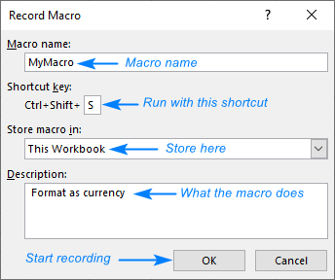
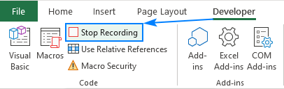
Start or Stop Recording

Slide 16
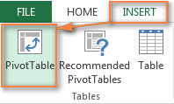
How to Add pivot Table:
Select any cell in the source data table, and then go to the Insert tab > Tables group > PivotTable.

Slide 17
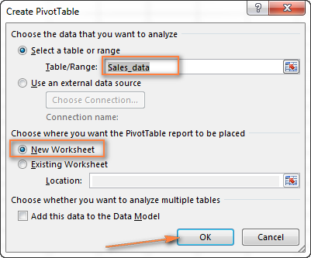
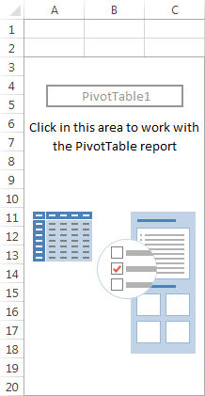

Slide 18
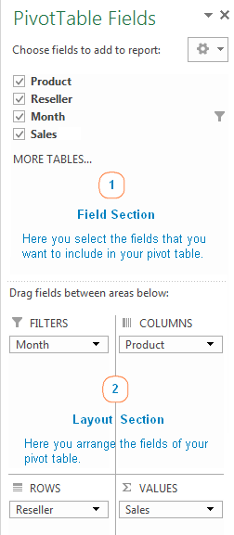
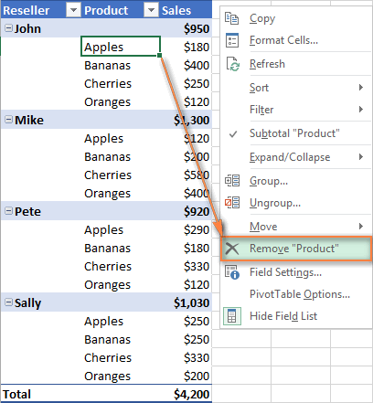
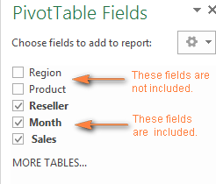

Slide 19
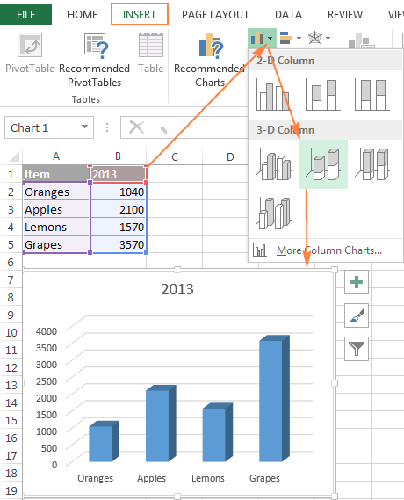
How to add a graph/chart:
Open your first Excel worksheet, select the data you want to plot in the chart, go to the Insert tab > Charts group, and choose the chart type you want to make. In this example, we will be creating the Stack Column chart:

Slide 20
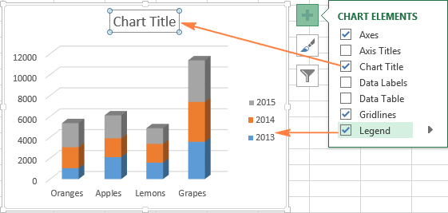
Select your graph, click the Chart Elements button (green cross) in the top right corner, and select the options you want

Slide 21
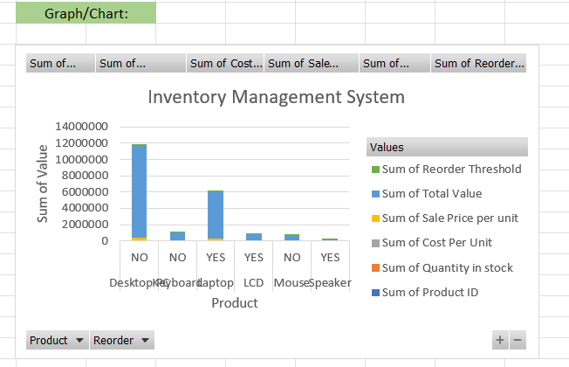

Slide 22
HTML
We created an Inventory System of Electronics through HTML and CSS using the following data:
Form should include Fields for item name, Item ID, Quantity, Price, Supplier Name etc;
Used basic HTML tags like <Form> <Input> <Label> <Header> <Button> and <Select>.
Added CSS styling for Layout, Fonts, Colours.

Slide 23
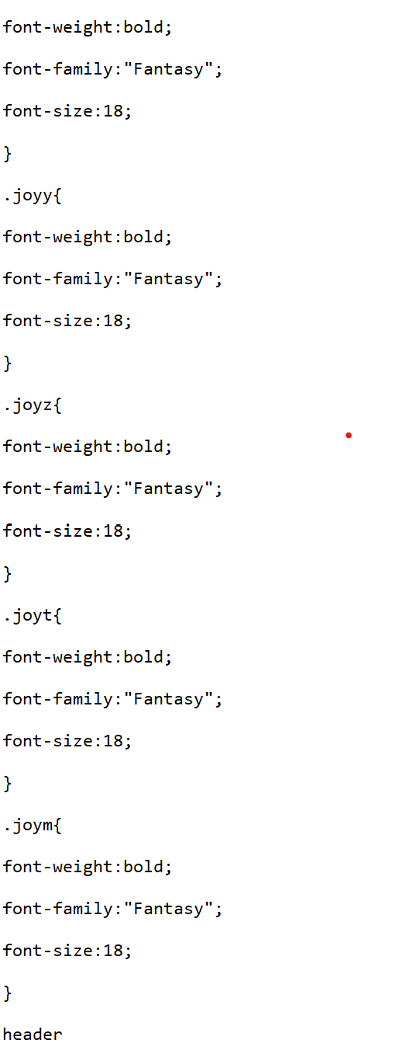
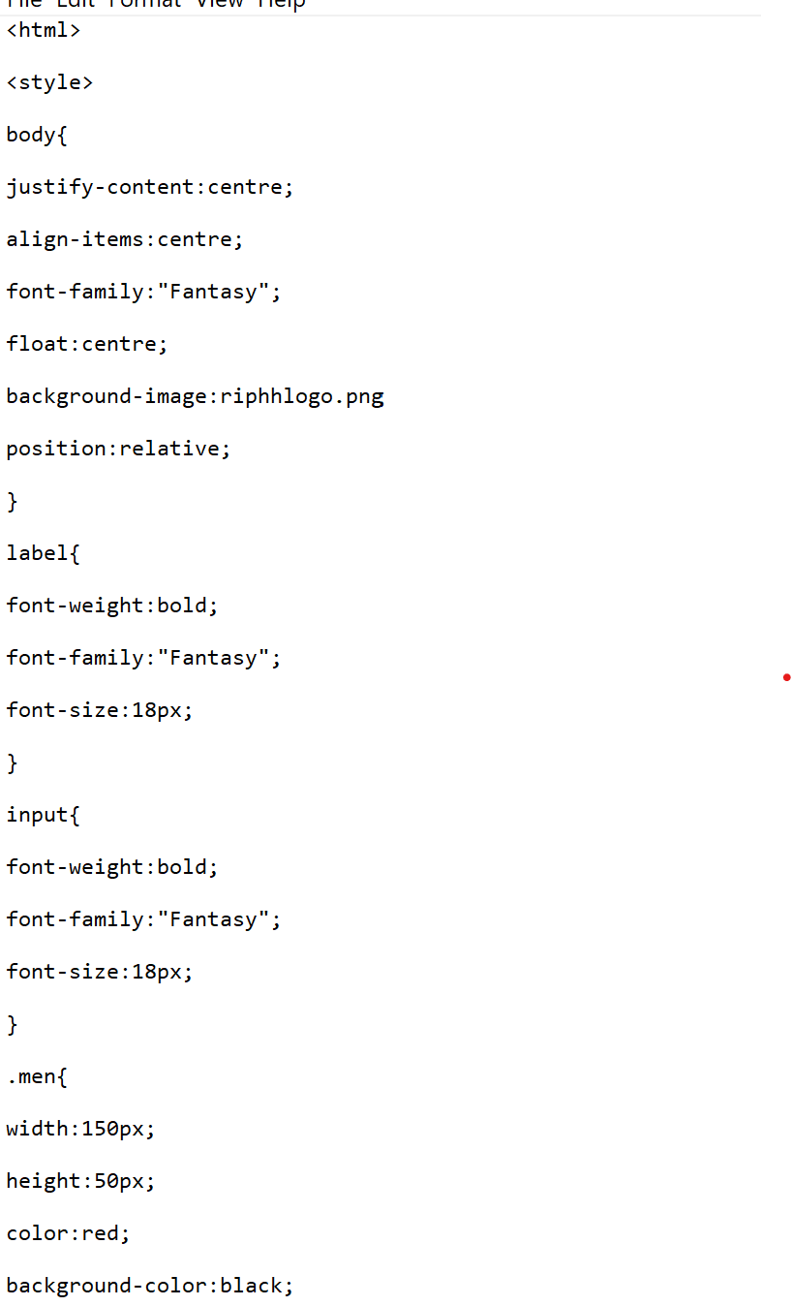
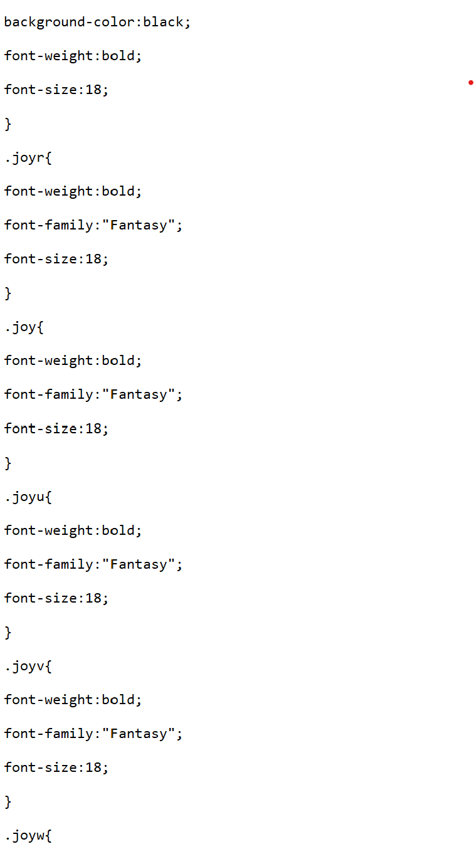
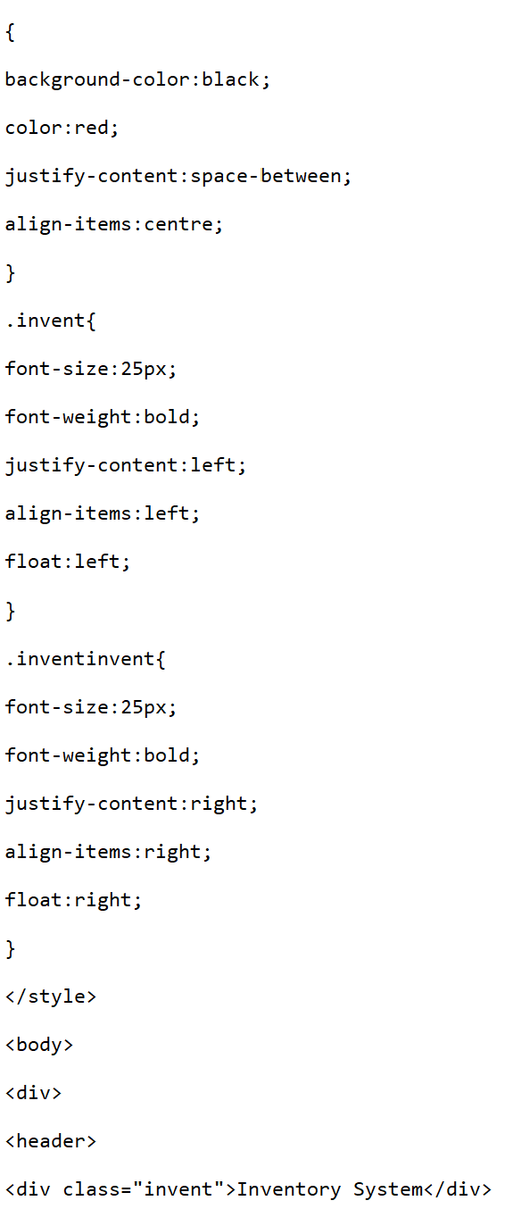
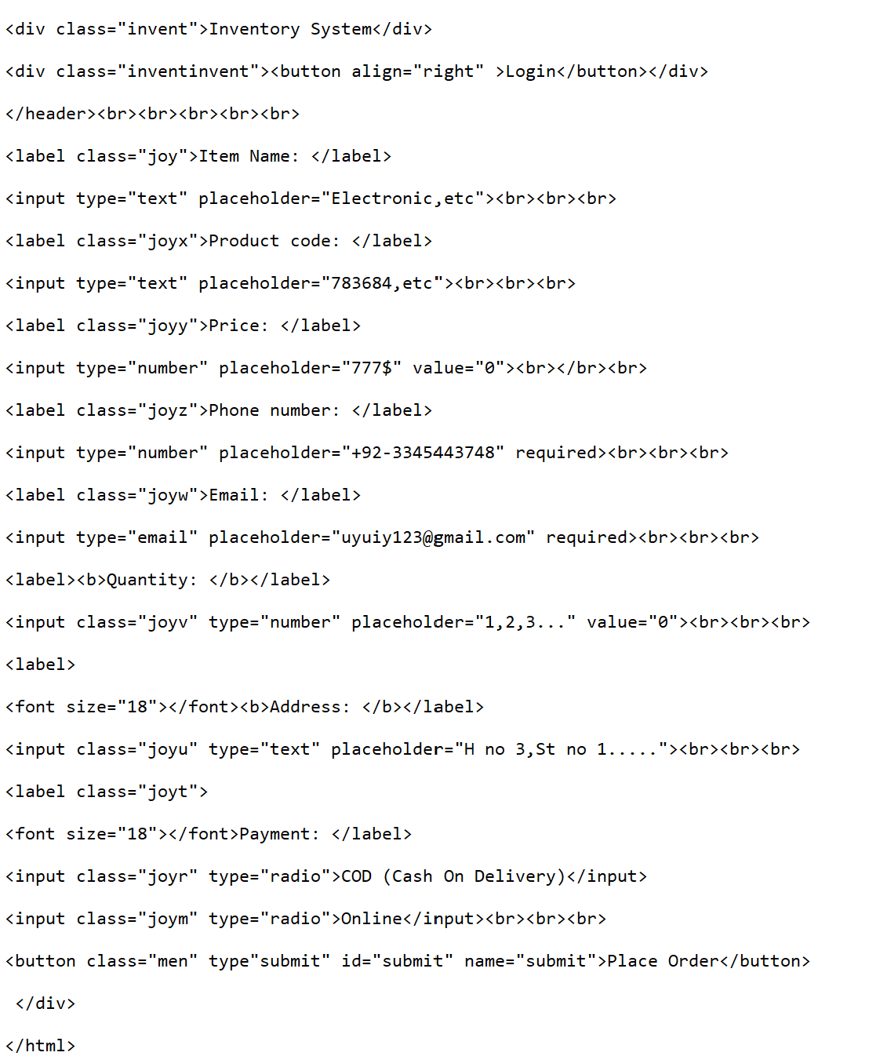
HTML/CSS
INPUT

Slide 24
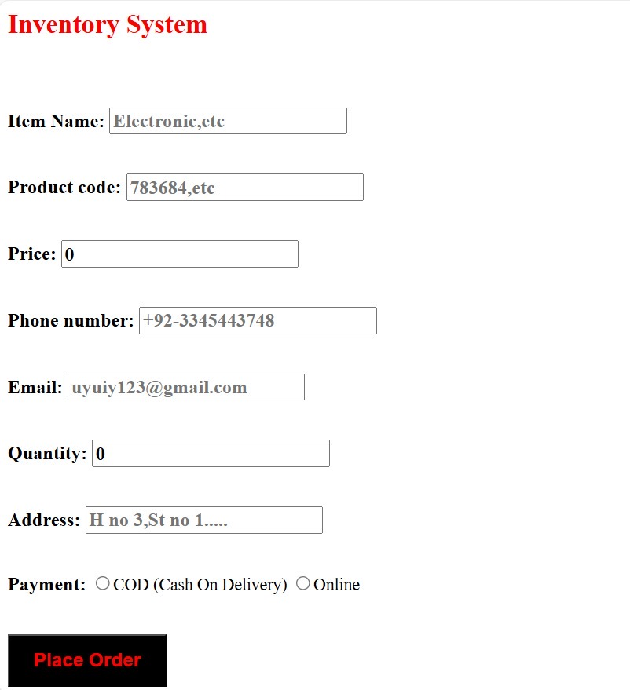
HTML/CSS
OUTPUT

Slide 25
MS PowerPoint
We used the following data for this PPTX file.
Slides explaining the steps for each tasks.
MS Word: Explaining Formatting, Structure, and Challenges.
MS Excel: Demonstrate the use of MICRO formulas, Pivot Tables, and Data Visualization.
HTML/CSS: Show the Form, Design, and Coding Process.
Used proper Theme and Transitions.
It includes Screenshots, Key learning.

Slide 26
Explanation
New Presentation
Open PowerPoint and click New.
Select Blank Presentation.
Change Font
Select text.
Choose font style and size from Home tab.
Bold / Italic / Underline
Select text.
Click B, I, or U in Home tab.

Slide 27
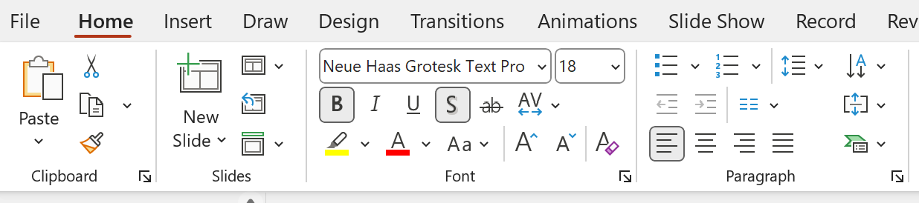

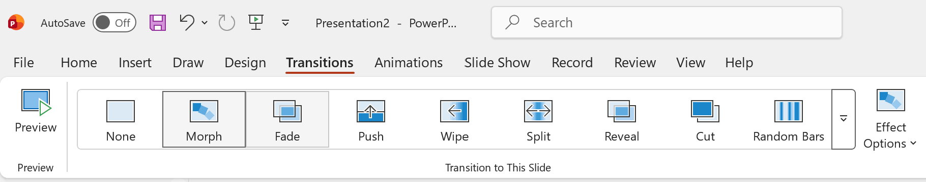

Slide 28
Conclusion
In conclusion, our presentation showed how Microsoft Office tools can be effectively used in real-life projects. We used MS Word for professional documentation, MS Excel for inventory management and data analysis, HTML/CSS for creating a basic inventory form, and MS PowerPoint to present our work clearly. This project improved our practical ICT skills and showed how these tools help save time, improve accuracy, and increase productivity in education and business.

Slide 29

Thank you for your time.
“Overall, this project strengthened our ICT skills and showed the importance of Microsoft and html + CSS Office in education and business.”

